Slide 1

Hub Location Selection
Kevin & Nina

Slide 2
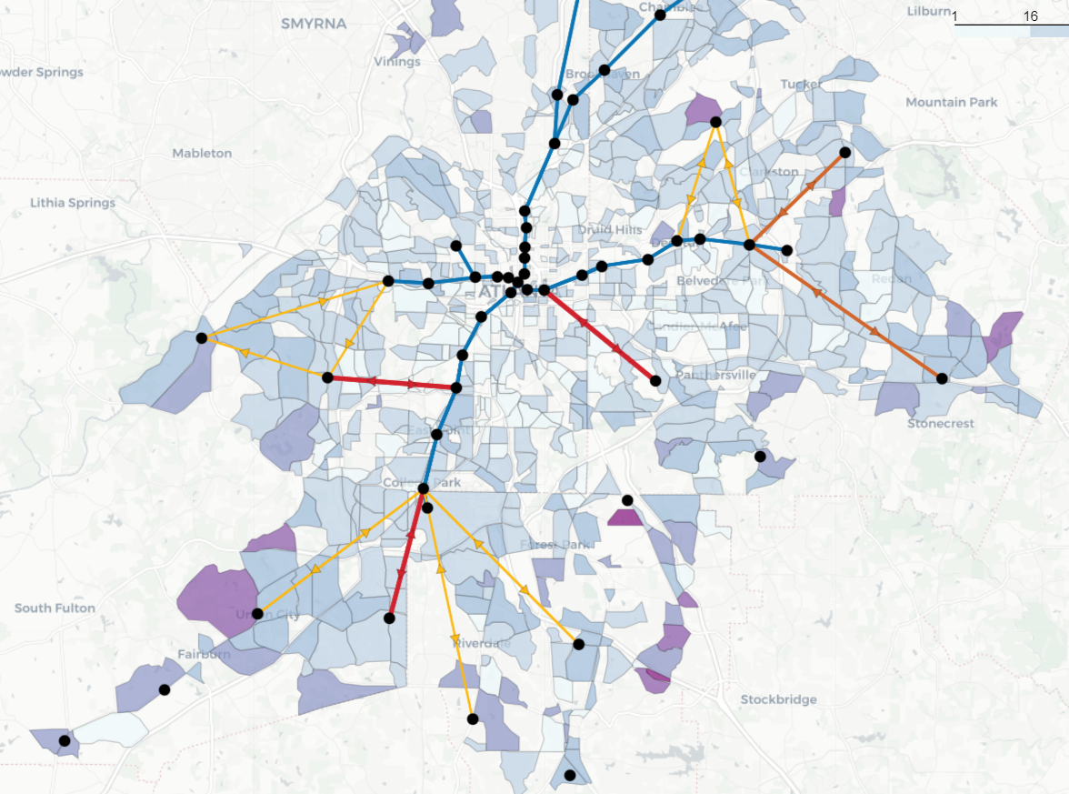
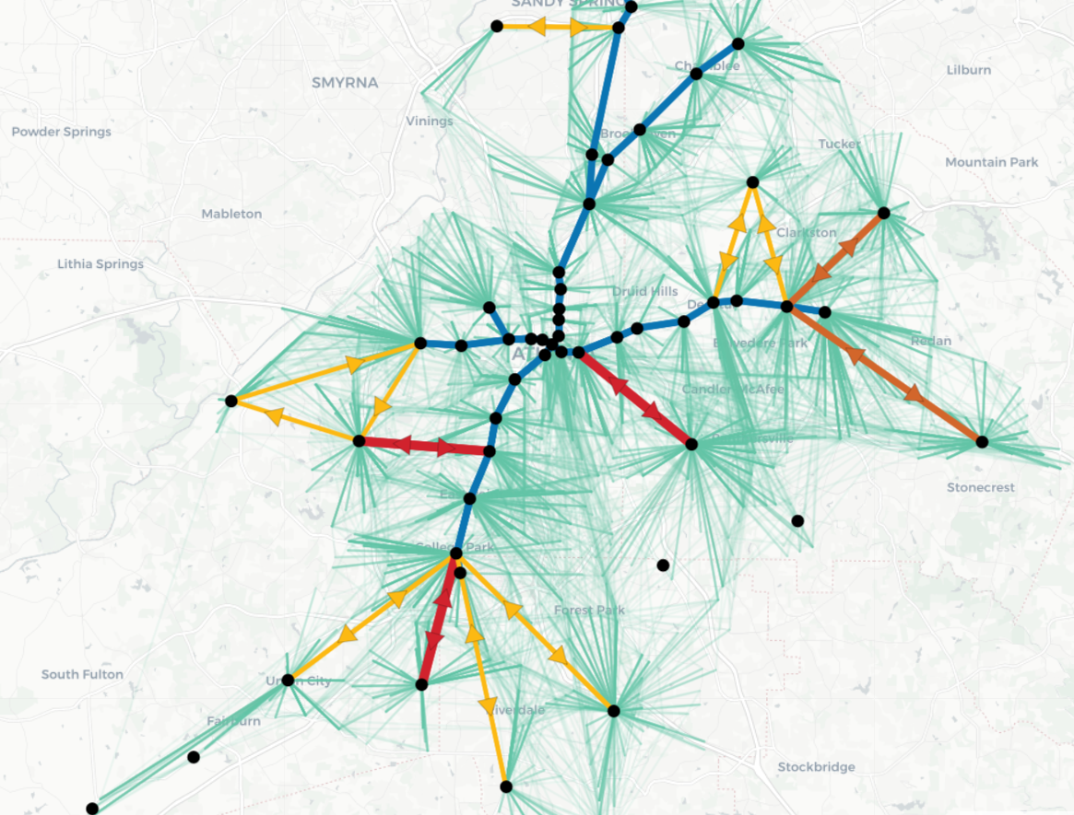
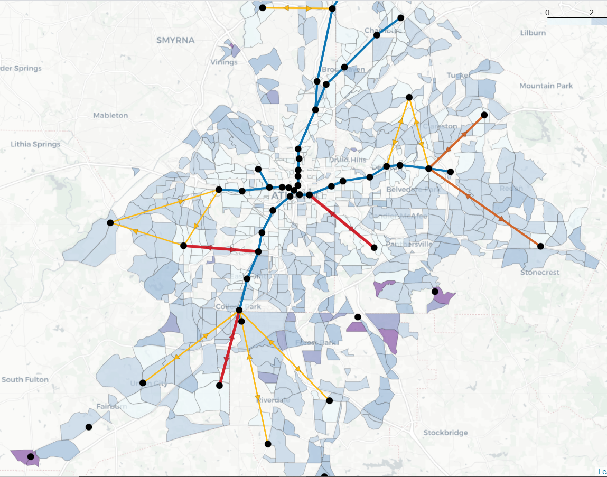
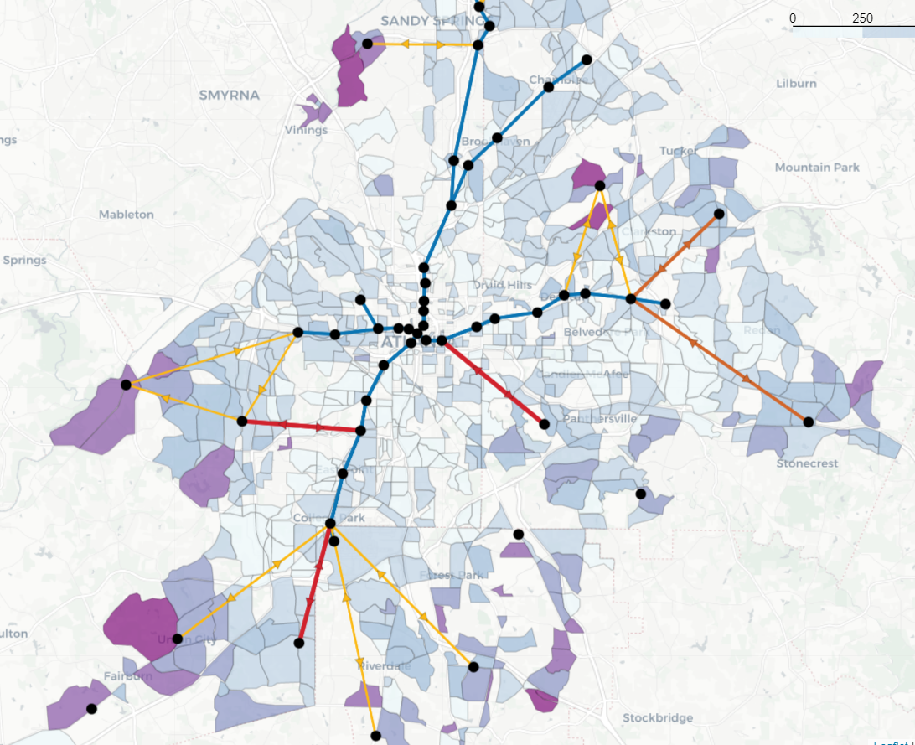
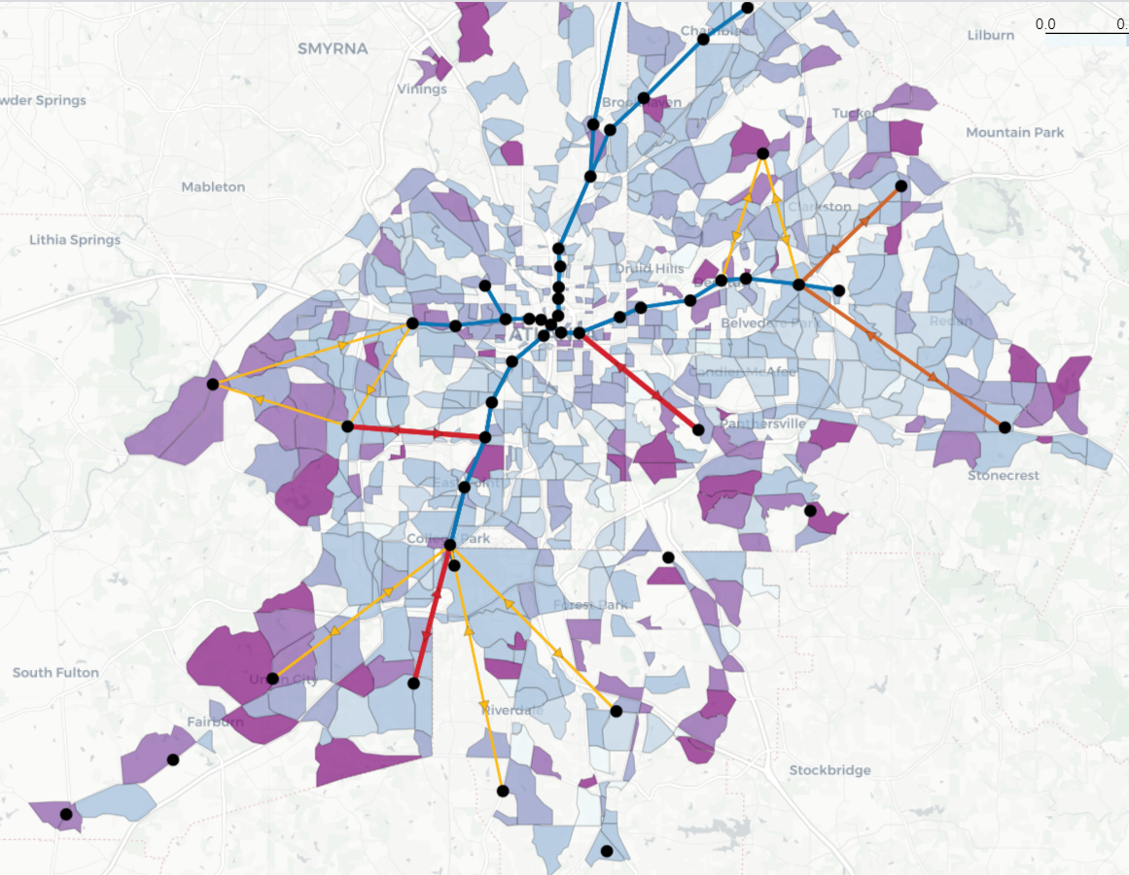
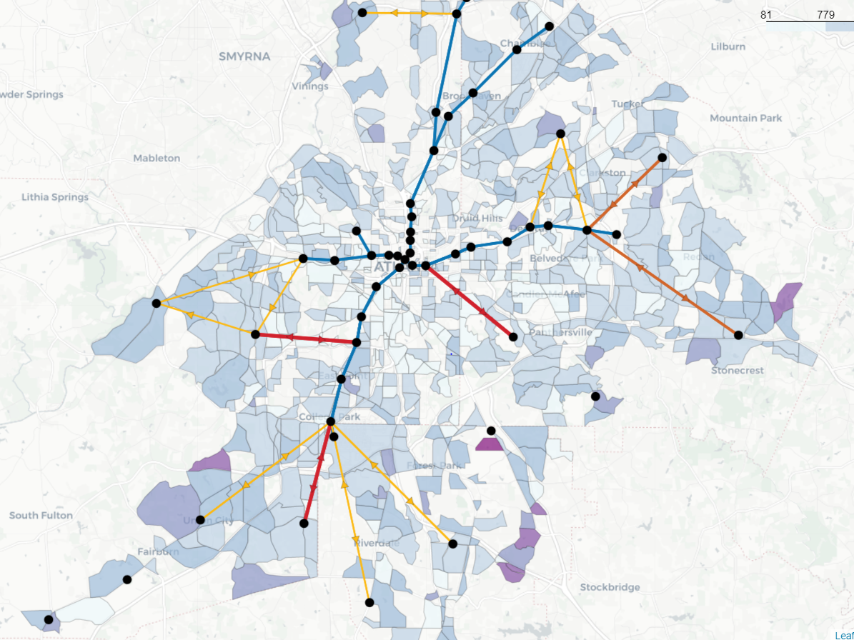
1. What we have
Current trip network design
Sample Trip evaluations
Trip cost
Travel time
Waiting time
Convenience
Number of transfers
Individual shuttle trip info

Slide 3
2. What we want to accomplish
Hub selection
Select parameters
Long, Lat, population density (can be calculated based on shuttle trip info)
Choose a clustering algorithm that generates the best meaningful results
Expectation
How many potential hubs do we want?
Possible method: Weighted K-Means, DBSCAN, HDBSCAN
Challenge
Currently we have a fixed amount of existing hub locations
May need to (1) modify clustering algorithm to have these location fixed OR (2) Ignore all current locations and let the algorithm produce its own result
Pros and cons for each option

Slide 4
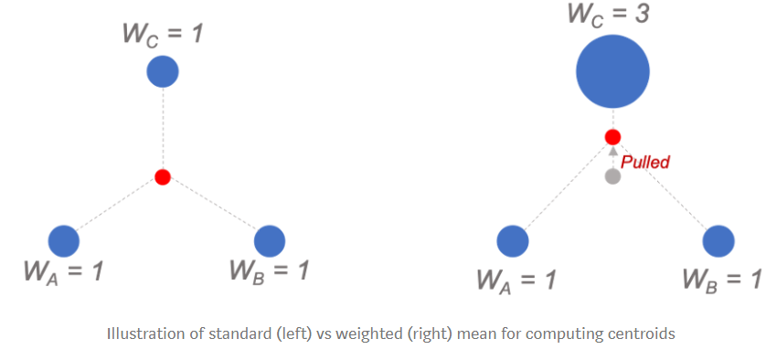
2.1 Weighted K-Means Clustering
Weight K-Means concept: locate centroids of clusters based on distance between all data points
Advantages:
Use weighted average instead of standard mean
Computationally easier comparing to other options
Link to “Weighted K-Means: Using Weighted K-Means Clustering to Determine Distribution Centres Locations” by Pararawendy Indarjo

Slide 5
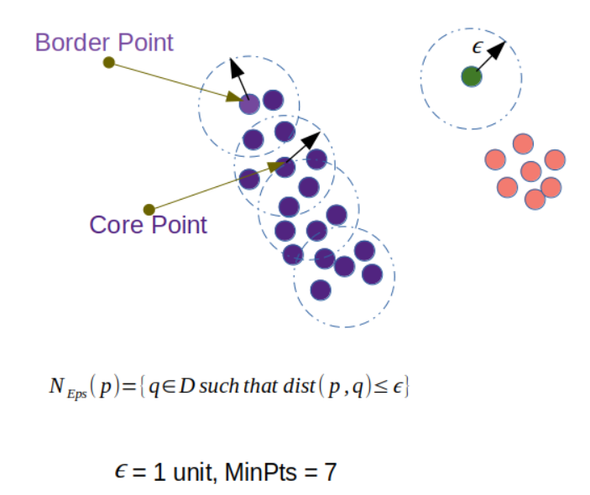
2.2 DBSCAN Clustering
DBSCAN concept: locate regions of high density that are separated from one another by regions of low density
Advantages:
require minimum domain knowledge
discover clusters of arbitrary shape
efficient for large database
Link to “A Density-Based Algorithm for Discovering
Clusters in Large Spatial Databases with Noise”
by Martin Ester
Epsilon - specifies how close points should be to each other to be considered a part of a cluster
MinPts - specifies how many neighbors a point should have to be included into a cluster

Slide 6
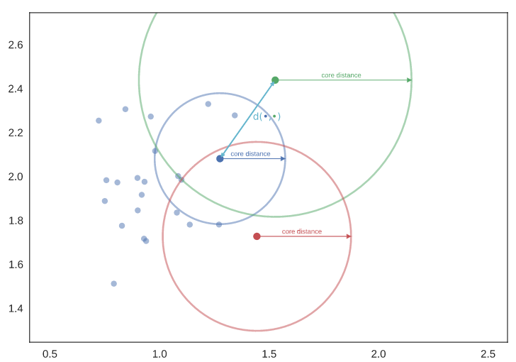
2.3 HDBSCAN Clustering
HDBSCAN concept: locate regions of high density that are separated from one another by regions of low density using hierarchical clustering
Advantages:
eliminating the need to tune distance
scale parameter epsilon
require minimum domain knowledge
discover clusters of arbitrary shape
efficient for large database
Link to “Understanding HDBSCAN and Density
-Based Clustering” by Pepe Berba

Slide 7
2. What we want to accomplish cont.
Optimization
Use current network design
Feed new hub locations into current network design and compare updated results manually
Takes a long time (possible if # of new hubs are not too many)
Design an evaluation tool
Define network cost function (based on the five parameters shown on page 1)
Input hub location set
Algorithm chooses and adds the best possible hub based on cost function
Fix the new hub location
Reiterate over the rest of the set until cost function cannot be reduced further
Benders Decomposition for the Design of a Hub and Shuttle Public Transit System by Arthur Maheo, Philip Kilby, Pascal Van Hentenryck
Questions and thoughts?

Slide 8
Hub location literature search
Summary of different facility location problems and applications
Facility location models for distribution system design
What are we looking for?
Uncapacitated or capacitated? (Do hub have infinite capacities)
Single allocation or multiple?
Areas of interests:
p-hub median problem: the number p of hubs to be located
p-hub centre problem: min the max travel time between two demand centres
dynamic hub location problem: where either cost, demands or resources may vary in the planning horizon

Slide 9
Hub location literature search cont.
Uncapacitated
HubLocator: an exact solution method for the multiple allocation hub location problem (2002)
Uncapacitated single and multiple allocation p-hub center problems (2009)
Robust uncapacitated multiple allocation hub location problem (2019)
Solving the Uncapacitated Single Allocation p-Hub Median Problem on GPU (2017)
Capacitated
The capacitated multiple allocation hub location problem: Formulations and algorithms (2000)

Slide 10
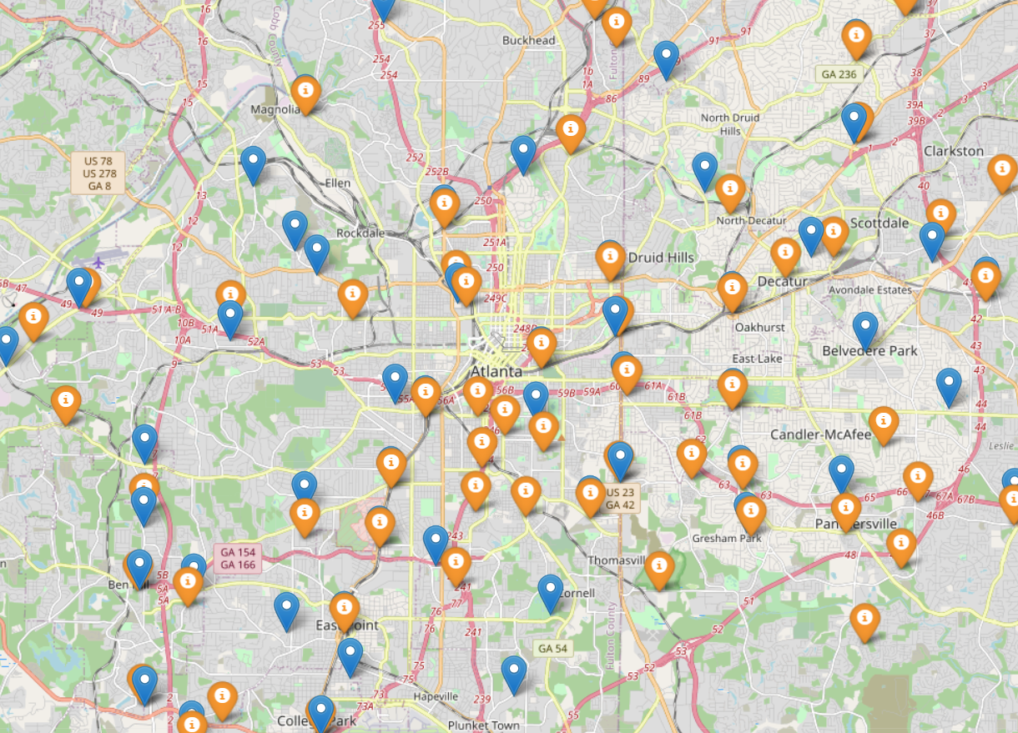
Optimization Draft
Goal
Select best potential hub locations to reduce overall transportation cost.
Data
Current hub location points: 57 locations obtained from odmts_main.py.
Potential hub location points: 92 locations obtained from board_id dataset using DBSCAN clustering
will test Weighted-Kmeans & HDBSACN later

Slide 11
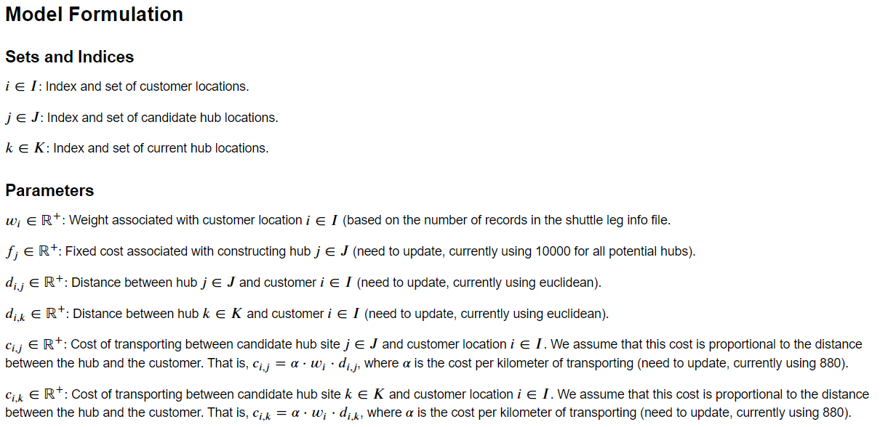
Optimization Draft Cont.

Slide 12
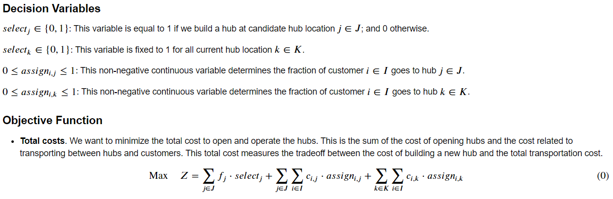
Optimization Draft Cont.

Slide 13
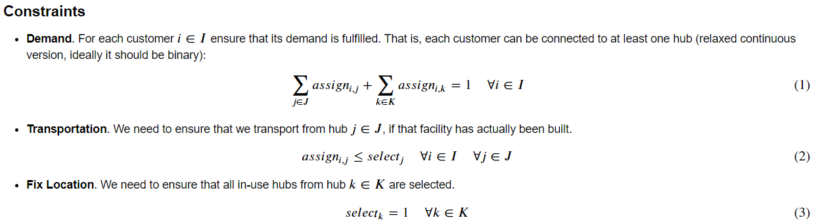
Optimization Draft Cont.

Slide 14
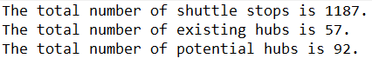
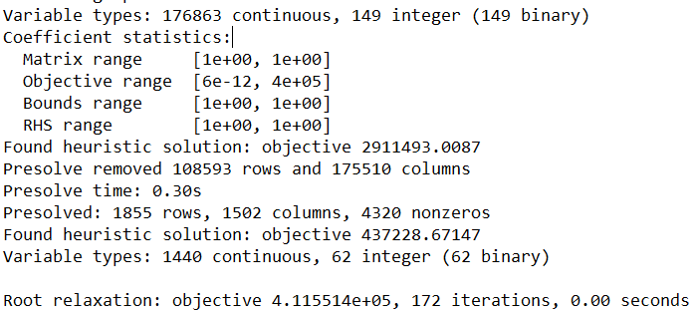
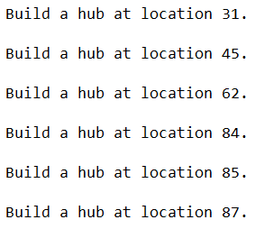
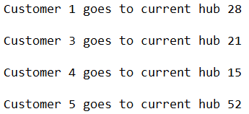
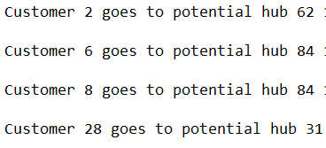
What the output shows
# of shuttle stops
# of existing hubs
#of potential hubs
Location of existing hubs
Location of selected potential hubs
Overall transportation cost
Which customer goes to which hub (whether go to an existing hub or a selected potential hub)

Slide 15
What’s next
Update distance/cost parameters
Feed potential hub results into the current network design
Observe changes in convenience, cost, travel time etc.
Adjust/polishing the current optimization model (take more factors into consideration)
Use Weighted K-Means and HDBSCAN to generate potential hubs
Compare optimization results (3 sets of potential hubs)

